Slide 1

MY SQL
PROJECT

Slide 2
MY SQL
INTRODUCTION
MySQL is the most popular open source relational database management system.
MySQL used for developing various web based software development.
Developed by company MySQL AB. (Based on CNC++)
SQL is used to insert, search, update, and delete database records.

Slide 3
Features of MYSQL
Relational Database Management System (RDBMS)
Easy to use
Storing Data is secure
Open Source & Free to download
Compatible on many Operating systems.

Slide 4
RDBMS
RDBMS stands for Relational Database Management System.
RDBMS is a program used to maintain a relational database.
RDBMS is the basis for all modern database systems such as MySQL, Microsoft SQL Server, Oracle, and Microsoft Access.
RDBMS uses SQL queries to access the data in the database.

Slide 5

SQL VS MY SQL
SQL
SQL is a query programming language that manages RDBMS.
SQL is primarily used to query and operate database systems.
SQL follows a simple standard format without many or regular updates.
SQL does not allow other processors or even its own binaries to manipulate data during execution.

Slide 6
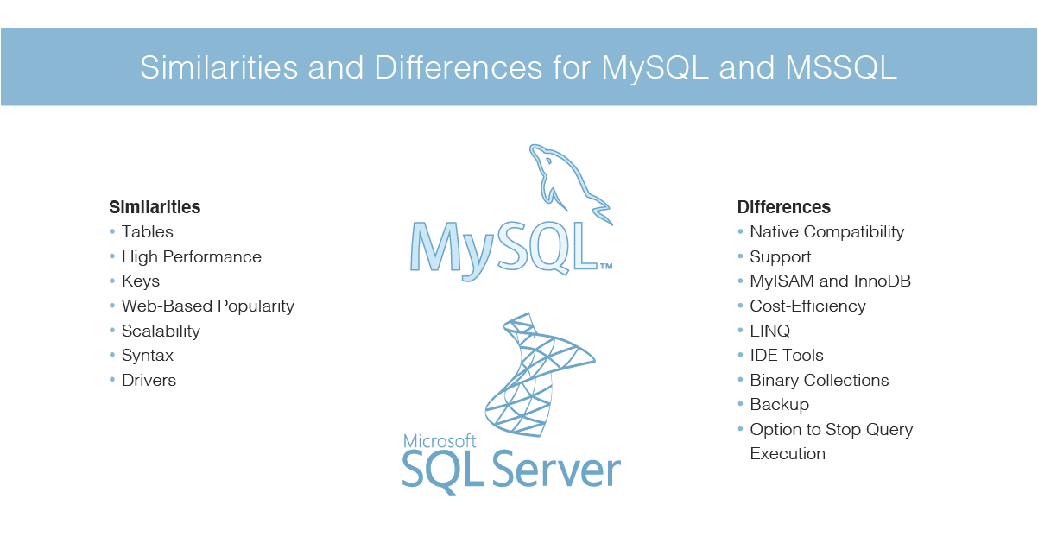
MY SQL
MySQL is a relational database management system that uses SQL.
MySQL allows you to handle, store, modify and delete data and store data in an organized way.
MySQL has numerous variants and gets frequent updates.
MySQL is less secure than SQL, as it allows third-party processors to manipulate data files during execution.

Slide 7
My SQL Main Commands
Create database (Create a New Database)
Show Databse (View Databases)
Drop Database
Alter Database (Modify Database)
Create Tables
Show tables
Insert Values
Drop Table
Alter table ( For New Column Creation)
Alter Table Modify
Alter table Drop ( Drop the Column)
ALter table Rename (Rename the Table)
Update Table ( To change the Values)
Delete Statement

Slide 8
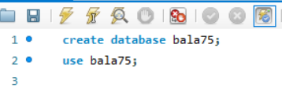
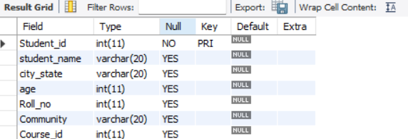
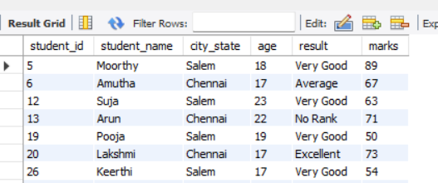
Create database
Create Tables
create table student_info (s_no int, student_name varchar(20),mark int, gender varchar(10),primary key(s_no));
OUTPUT :-
Insert Values
insert into Student_info values
OUTPUT :-

Slide 9
My SQL General Functions
Where
or
and
in
Not in
>
<
>=
<=
<> (Not equal to)
!
Count
Distinct
Count With Distinct
Order by Asc
Order By Desc
Group By
Limit
Desc Limit
Like (_%)
Not like
Between

Slide 10
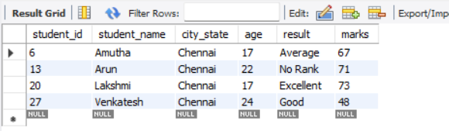
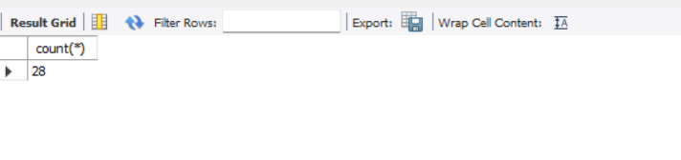
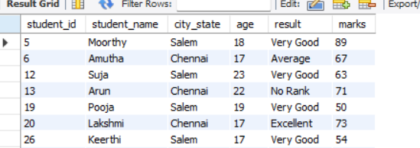
Where
select * from student_details where city_state='chennai';
OUTPUT :-
COUNT
select count(*) from student_details;
OR
OUTPUT :-
select * from student_details where city_state='chennai'or city_state='Salem';
OUTPUT :-

Slide 11
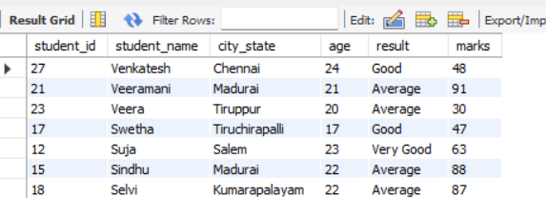
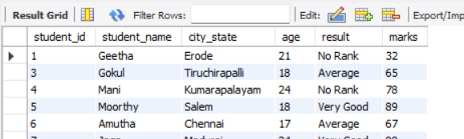
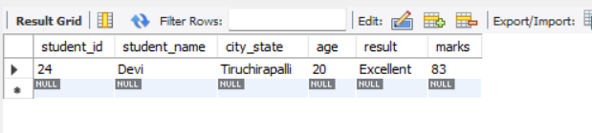
Order by
select*from student_details order by student_name desc;
OUTPUT :-
Like
select*from student_details where student_name not like 'G__U';
OUTPUT :-
Like
select*from student_details where student_name like '__vi';
OUTPUT :-

Slide 12
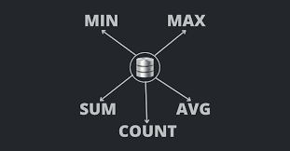

MY SQL Calculate Functions
Sum
Average
Min
Max
Count

Slide 13
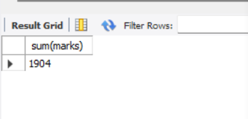
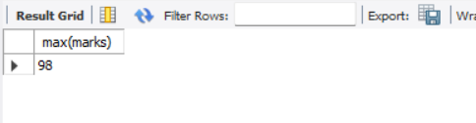
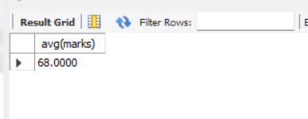
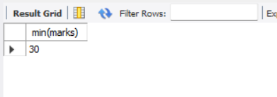
Sum
Maximum
select sum(marks) from student_details;
select max(marks) from student_details;
OUTPUT :-
OUTPUT :-
Average
Minmum
select avg(marks) from student_details;
select min(marks) from student_details;
OUTPUT :-
OUTPUT :-

Slide 14
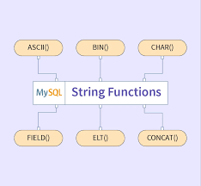

My SQL String Functions
LCase
UCase
Left
Right
Concat
Trim
Char_Length
Mid
Length

Slide 15
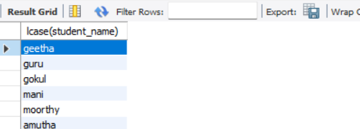
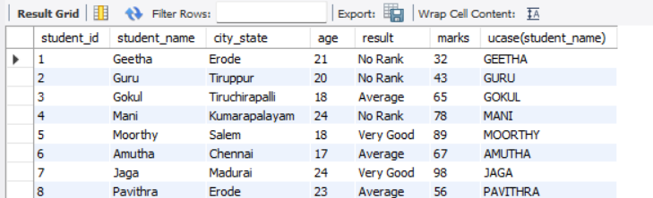
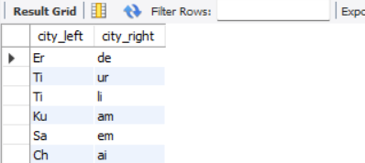
LCase
UCase
select lcase(student_name)from student_details;
select*, ucase(student_name)from student_details;
OUTPUT :-
OUTPUT :-
Left,Right
select left (city_state,2) as city_left, right(city_state,2) as city_right from student_details;
OUTPUT :-

Slide 16
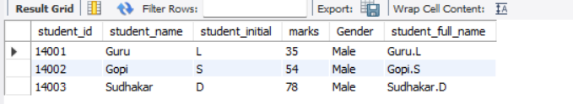
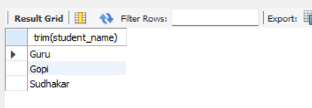
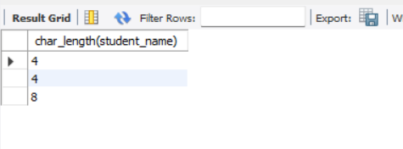
Concat
Trim
select *,concat(student_name,".",student_initial) as student_full_name from student_form;
select trim(student_name) from student_form;
OUTPUT :-
OUTPUT :-
Char_Length
select char_length(student_name) from student_form;
OUTPUT :-

Slide 17
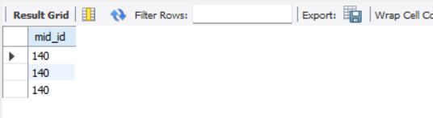
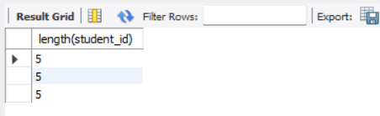
Mid
select mid(student_id,1,3)as mid_id from student_form;
OUTPUT :-
OUTPUT :-
Length
select length(student_id) from student_form;

Slide 18

My SQL Date Functions
Date ADD
Datediff
Timestamp DIff
Date Format
Year
Day
Month
Now

Slide 19
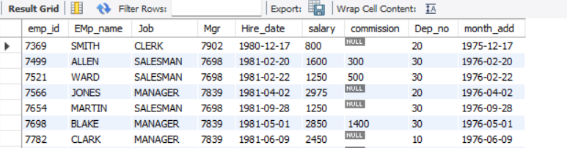
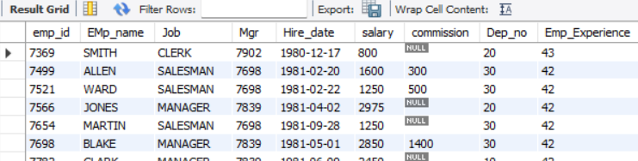
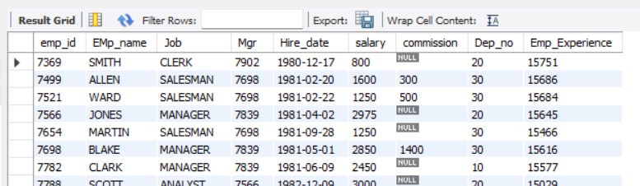
Date ADD
Timestamp DIff
select*, date_add(hire_date, interval -5 year) as month_add from Emp_det;
select*, timestampdiff(year,hire_date,curdate()) as Emp_Experience from emp_det;
OUTPUT :-
OUTPUT :-
Datediff
select*, datediff(curdate(), Hire_date) as Emp_Experience from emp_det;
OUTPUT :-

Slide 20
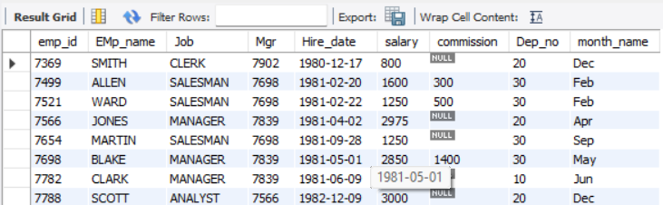
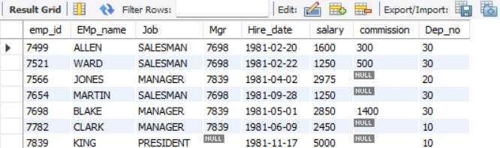
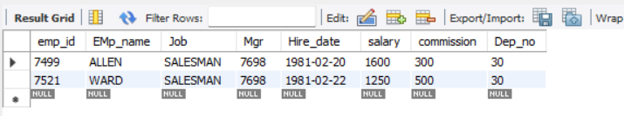
Date Format
Year
select*, date_format(hire_date, '%b') as month_name from emp_det;
select* from emp_det where year(hire_date)='1981';
OUTPUT :-
OUTPUT :-
Month
select *from emp_det where month(hire_date)='2';
OUTPUT :-

Slide 21
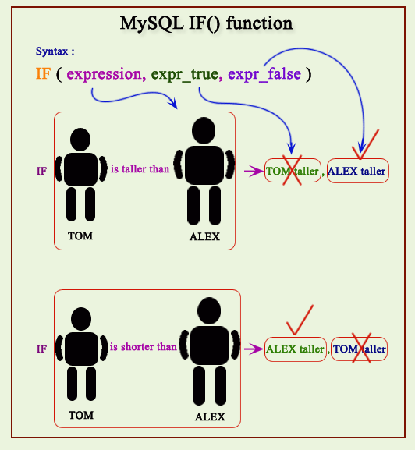
Logical Functions
IF
If with and conditons
If with or conditions
Count If

Slide 22
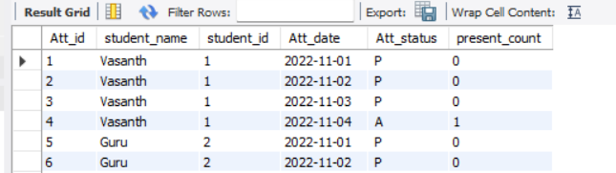
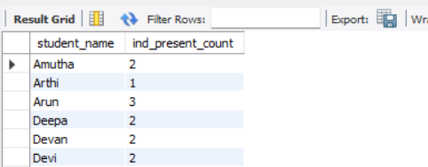
IF
select*, if(Att_status = ' A','1','0')as present_count from Att_info;
OUTPUT :-
Count If
select student_name, count(att_status) as ind_present_count from Att_info where att_status= ' p' group by student_name;
OUTPUT :-

Slide 23
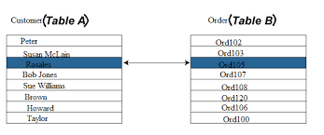
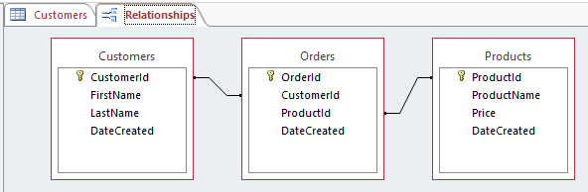
RDBMS System
Two table connection
Data can be linked between two or more tables with the help of primary key and foreign key constraints.
Referential integrity helps to avoid:
Adding records to a related table if there is no associated record available in the primary key table.
Three table connection
There may occur some situations sometimes where data needs to be fetched from three or more tables. This article deals with two approaches to achieve it.

Slide 24
Join Queries
MySQL databases usually store large amounts of data.
To analyze that data efficiently, analysts and DBAs have a constant need to extract records from two or more tables based on certain conditions.
That’s where JOINs come to the aid.
Inner Join
Left Join
Right Join
Cross join
Full Outer Join

Slide 25

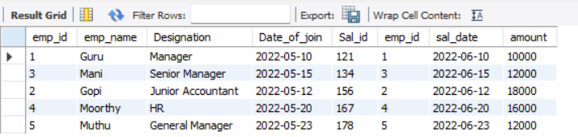
Inner Join
select* from emp_details inner join sal_details on emp_details.emp_id = sal_details .emp_id;
OUTPUT :-

Slide 26

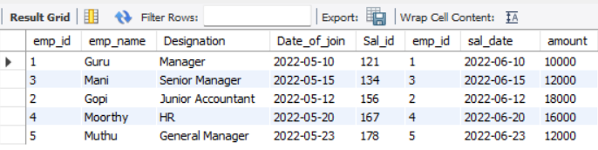
Right Join
select* from emp_details right join sal_details on emp_details.emp_id = sal_details .emp_id;
OUTPUT :-

Slide 27

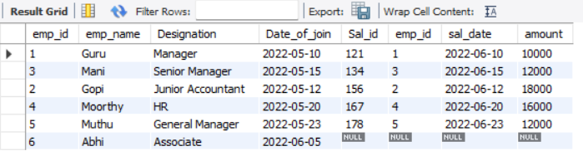
Left Join
select* from emp_details left join sal_details on emp_details.emp_id = sal_details .emp_id;
OUTPUT :-

Slide 28
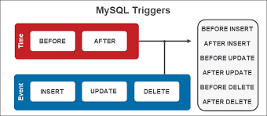
Triggers
Before insert
After insert
Before update
After update
Before delete
After delete

Slide 29
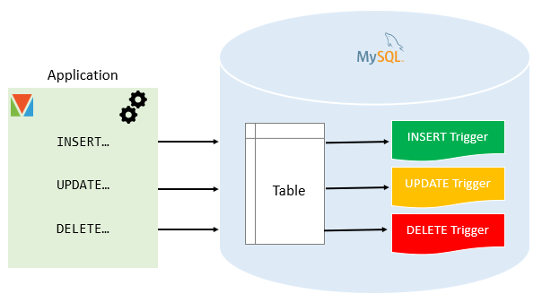

Slide 30
“Failure is a bend in the road, not the end of the road”
THANK YOU

